Slide 1
ADVANCE AUTO PARTS
PROJECT 5

Slide 2




MEET THE TEAM
Sukhsagar Jaiswal
Snehalatha Doddigarla
Srishti Bisen
Vikas Das

Slide 3
AGENDA
Project objective
Exploratory data analysis
Data transformation and variable selection
Bootstrapped clustering of stores
Cluster evaluation
Mapping new stores to clusters
Forecast sales of clusters

Slide 4
FORECAST SALES OF NEW STORES
PROJECT OBJECTIVE
Forecast sales of new stores by analyzing sales history, demographics and characteristics of existing stores

Slide 5
BUSINESS BENEFITS
Successful clustering and time series forecasting for Advanced Auto Parts translates to increased sales forecast accuracy for tagged new stores by more than
8% over forecasting without clustering

Slide 6
PROJECT DATA
Store Detail
Type
Store_Number
DMA
City
State
Total aap cq units
Total failure units
Total market share
DIY aap cq units
DIY failure units
DIY market share
DIFM aap cq units
DIFM failure units
DIFM market share
Demographics
Store_Number
Area_Land
Area_Water
Pop_Male
Pop_Female
Age
…
Median_Household_Income
Establishments
Employees
Sales History
Store_Number
Fiscal_Year
Fiscal_Period
MPOG_ID
Customer_Type
Sum(Qty_Sold)
Sum(Gross_Sales)
VIO_Store_Number_Aces
Store_Number
Base_vehicle_ID
Vehicle_Count
Unadjusted_Vehicle_Count
Vehicle_Count_PY
Unadjusted_Vehicle_Count_PY
SKU Aces
MFG_Code
MFG_Part_Number
SKU_Number
MPOG_ID
Base_Vehicle_ID
Model_Year
Make
Model
Min_Aap
VIO_Sector_ID
Sector_ID
Base_Vehicle_ID
Vehicle_count
Vehicle_count_PY

Slide 7
PROJECT PLAN
Week 1 (1/17) | Week 2 (1/24) | Week 3 (1/31) | Week 4 (2/7) | Week 5 (2/14) | Week 6 (2/21) | Week 7 (2/28) | Week 8 (3/6)
Kickoff meeting
Data understanding, clarifications and EDA
Literature review
Date preparation and Modelling
Solution presentation and feedback
Model improvement
3/6/20
Final presentation
Project handover and KT
Today(03/06)
Completed
Yet to start

Slide 8


SOFTWARE AND TOOLS
We used R for modeling and Tableau for visualizations
Libraries and Packages:
Bootstrapped clustering: dplyr, cluster, factoextra, fpc, clValid, fastDummies, ggplot2
Mapping stores to clusters with k-NN: Caret
Time Series Forecasting: tidyverse, forecast, boot, tseries, cowplot, lubridate, Tsstudio, Mlmetrics

Slide 9
DATA EXPLORATION
Data Understanding & Distribution of sales
Test whether data has Time Series components such as Trend and Seasonality

Slide 10
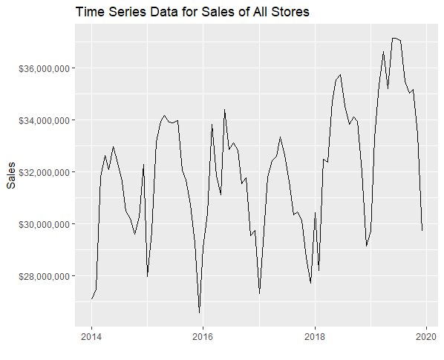
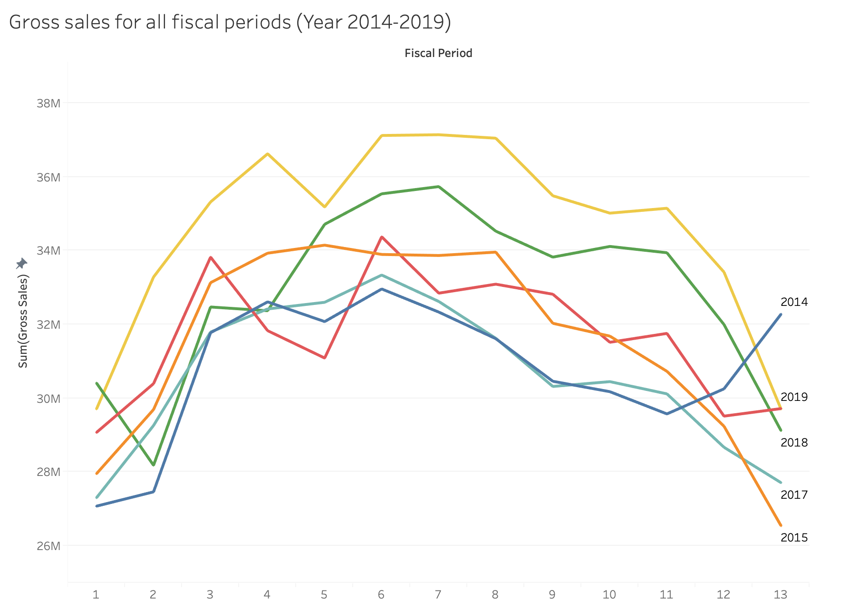
DATA EXPLORATION – CHECKING FOR SEASONALITY
TREND
SEASONALITY
Decomposition
Data is Non-Stationary (presence of trend and seasonality)
Data can be Decomposed to get Stationary Data
A stationary data is one which has constant mean, constant variance and constant covariance

Slide 11
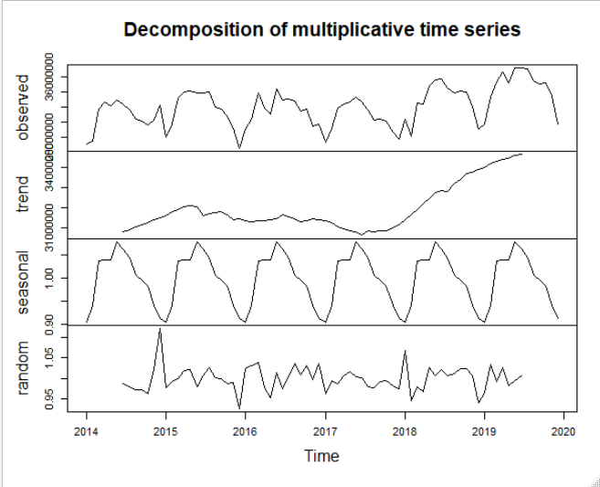
DECOMPOSITION CHART FOR SALES

Slide 12




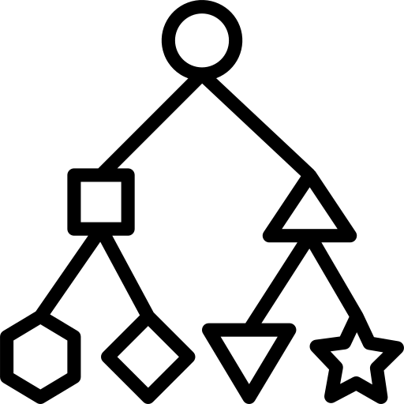

SOLUTION DESIGN
Exploratory Data Analysis
Clustering
Forecast
Find table relationships and correlations
Cluster Stores based on demographics, store attributes and vehicle data
Forecast sales using average sales of respective cluster
Data Preparation
Map New Store
Results and Conclusion
Geo-encode city and state details,
remove highly correlated variables
Map New Store to existing clusters
Provide recommendations
derived from insights

Slide 13
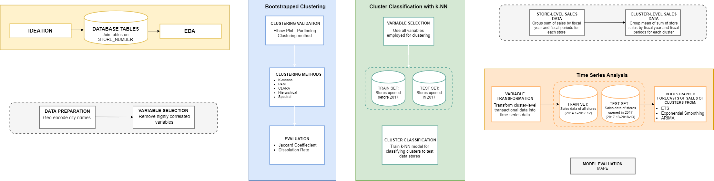
PROCESS FLOW

Slide 14
CLUSTER STORES
Group stores that are similar based on store demographics and other characteristics
Map New Store to a relevant cluster

Slide 15
FEATURE ENGINEERING
One Hot Encode: Customer_Type, DMA
Fiscal_Period/Fiscal_Year: Use these Time Fields to decompose sales into seasonality and trend
VIO: Vehicles in operations can be used to estimate possible demand and can be used during clustering

Slide 16
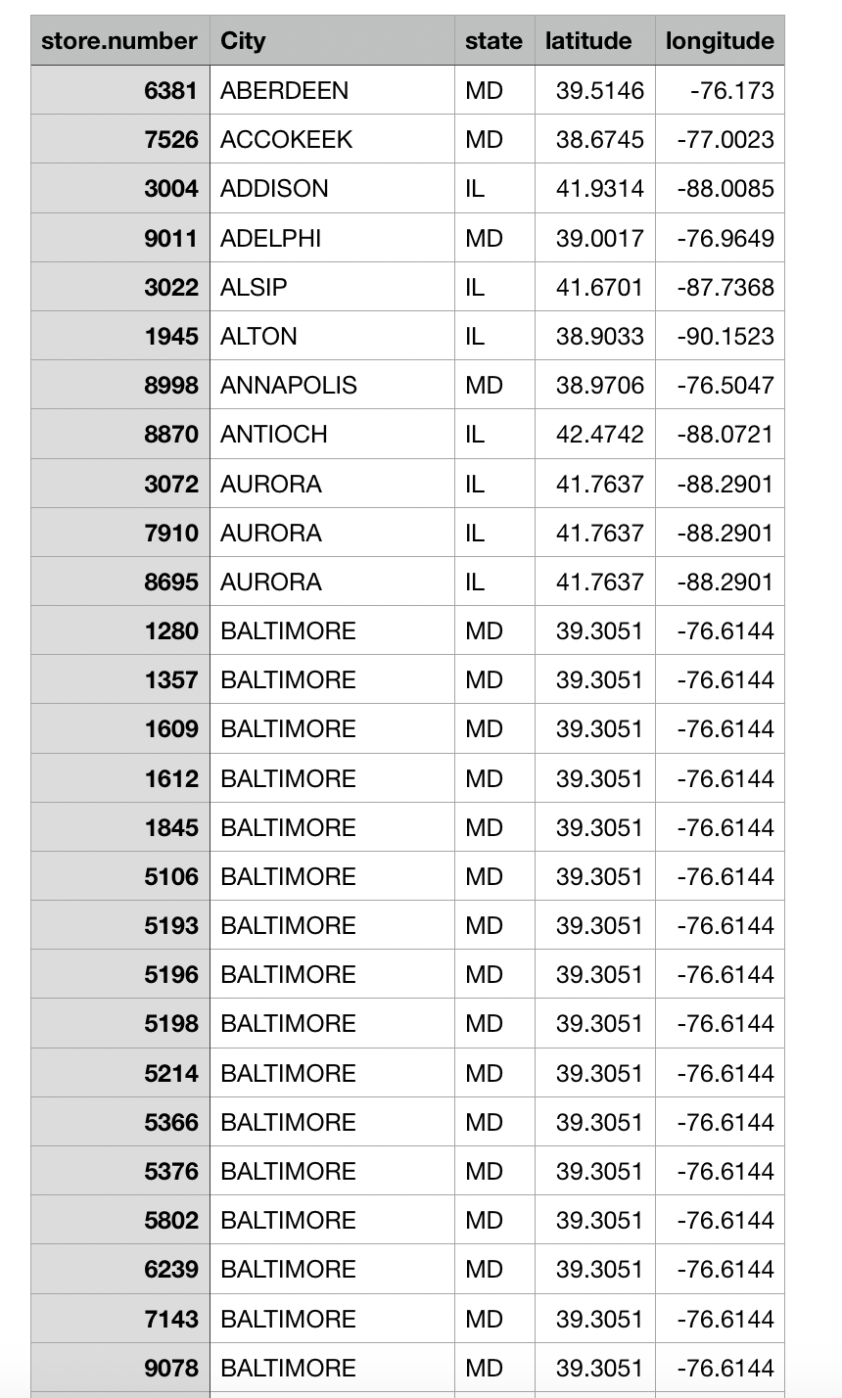
GEO-ENCODING
Encoding city and state details into latitudes and longitudes

Slide 17
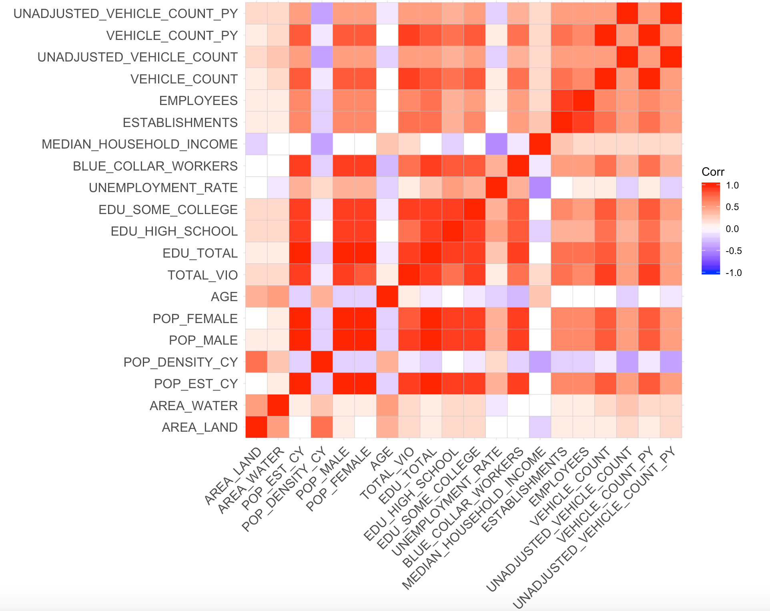
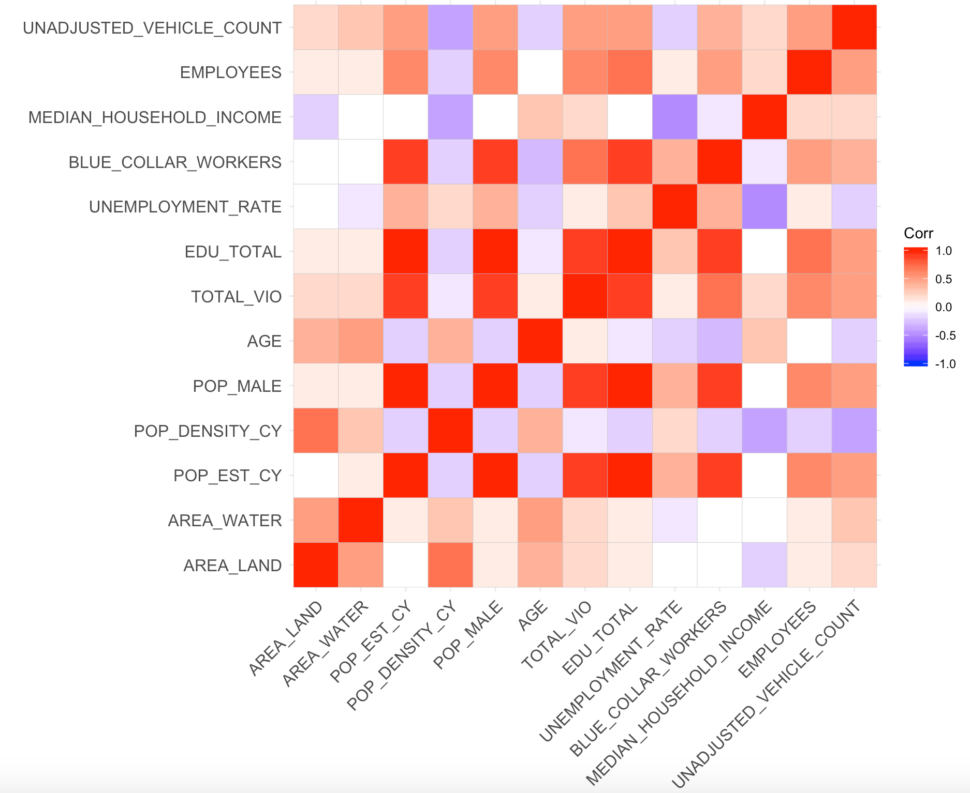
CORRELATION PLOTS
Correlation of all variables
Correlation of selected variables

Slide 18
RESULTS
Clustering Methods​ | Optimal Number of clusters​ | Maximum Jaccard Coefficient​ | Minimum Jaccard Coefficient​ | Dunn​ | Silhouette​ | Connectivity​
PAM​ | 10​ | 0.867​ | 0.7​ | 0.0149​ | 0.41​ | 61.53​
K-means​ | 7​ | 0.74​ | 0.503​ | 0.0602​ | 0.4889​ | 59.035​
CLARA​ | 10​ | 0.88​ | 0.49​ | 0.0173​ | 0.447​ | 84.111​
Hierarchical​ | 8​ | 0.93​ | 0.505​ | 0.0906​ | 0.43​ | 37.56​
Spectral​ | 6​ | 0.745​ | 0.63​ | ​ | ​ | ​

Slide 19
PAM: PARTIONING AROUND MEDOIDS
Finds a sequence of objects called medoids that are centrally located in clusters
​Minimizes the average dissimilarity of objects to their closest selected object​
It is intuitive and robust​
Less sensitive to noise and outliers
It is intensive if the data is huge​

Slide 20
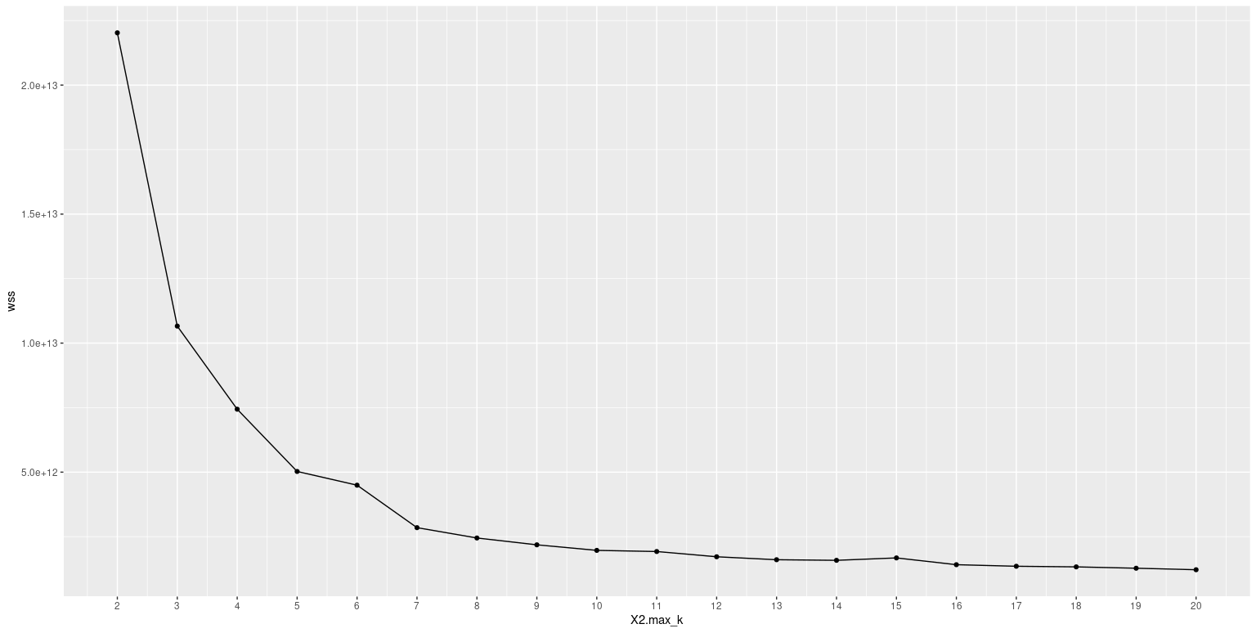
ELBOW PLOT
Number of clusters​ | Maximum Jaccard Coefficient​ | Minimum Jaccard Coefficient​ | Maximum Dissolution​ | Minimum Dissolution​
5​ | 0.76​ | 0.508​ | 8​ | 63​
7​ | 0.78​ | 0.505​ | 60​ | 10​
10​ | 0.867​ | 0.7​ | 37​ | 9​
12​ | 0.84​ | 0.56​ | 53​ | 7​

Slide 21
BOOTSTRAP EVALUATION OF CLUSTERS
Evaluates stability of the cluster​
Jaccard coefficient and Number of times a cluster was dissolved
clusterboot()​
Bootmethod​
Methods used​
Best clustering method: PAM

Slide 22
CLUSTER VALIDATION
Function for Cluster Analysis: clValid
Types of cluster validation:​
1. Internal: Dunn, Silhouette, and Connectivity​
2. Stability: Average Distance, Average distance between means​
​
​

Slide 23
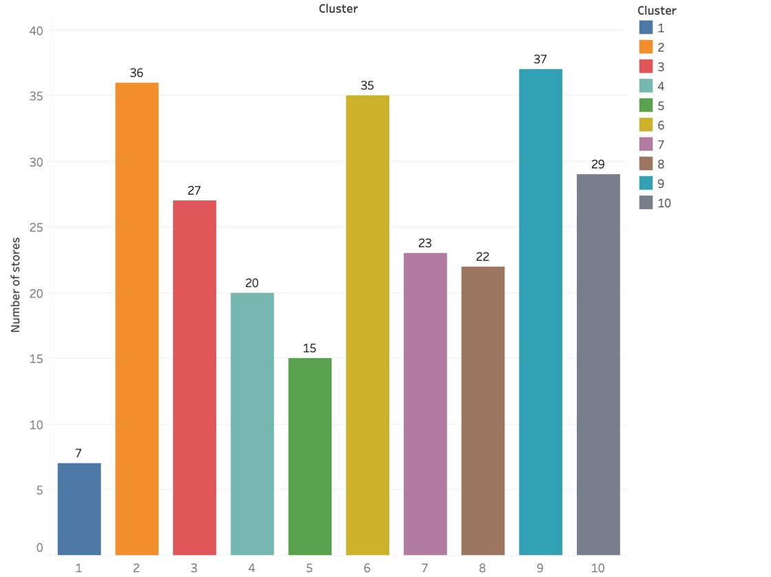
STORE DISTRIBUTION ACROSS CLUSTERS

Slide 24
CLUSTER EVALUATION
Visually evaluate clusters through Tableau dashboard

Slide 25
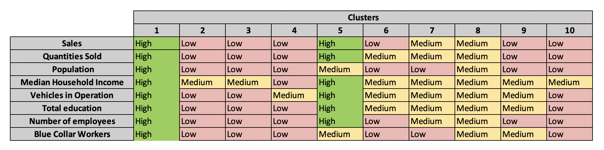
Cluster Evaluation

Slide 26
MAP NEW STORES TO CLUSTERS
Map new stores to clusters using k-NN classification approach

Slide 27
K-NN TO CLASSIFY NEW STORES TO CLUSTERS
K-NN stands for K-Nearest neighbors
Simple, easy-to-implement supervised machine learning algorithm that can be used to solve both classification and regression problems
Different from K-means which is an unsupervised machine learning algorithm
A case is classified by a majority vote of its neighbors, with the case being assigned to the class most common amongst its K-nearest neighbors measured by a distance function

Slide 28
FORECASTING SALES
Explore time series forecasting models
Evaluate best model by MAPE
Test model on a store

Slide 29
FORECAST ACCURACY RESULTS
Time series forecasting techniques | Store 7521 | Store 7848 | Store 7755 | Store 7910
Holt-Winters | 90.4% | 87.6% | 38.6% | 0%
Bagged Holt-Winters | 90.5% | 88.8% | 39.5% | 0%
ETS | 90.4% | 91.9% | 28.7% | 0%
Bagged ETS | 90.6% | 91.3% | 35.0% | 0%
ARIMA | 91.7% | 90.3% | 42.4% | 0%
Bagged ARIMA | 91.2% | 89.9% | 40.4% | 0%
Accuracy percentage calculated for test period from 2017.13 through 2018.13
Negative accuracy is imputed with zero

Slide 30
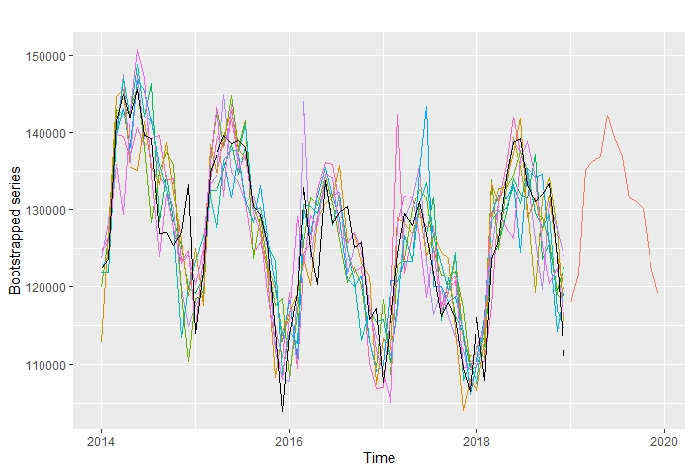
BOOTSTRAP OF TIME-SERIES DATA

Slide 31
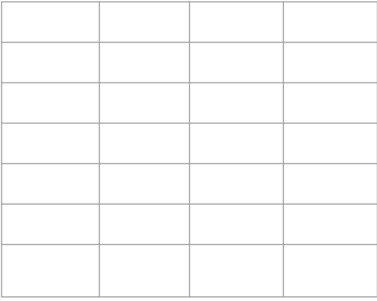

MODEL EVALUATION
Actual | Forecast | $A_{t}$ - $F_{t}$ | |$A_{t}$ - $F_{t}$|
5 | 10 | -5 | 5
10 | 5 | 5 | 5
20 | 15 | 5 | 5
30 | 35 | -5 | 5
50 | 60 | -10 | 10
Total = 115 |  |  | Total = 30
MAPE = $\frac{1}{n}∗ε(\frac{A_{t}\text{ − }F_{t}}{A_{t}})$
In our example MAPE = $\frac{1}{5}∗\frac{30}{115}$ = 0.052
Accuracy = (1-MAPE)*100% = 94.8%

Slide 32
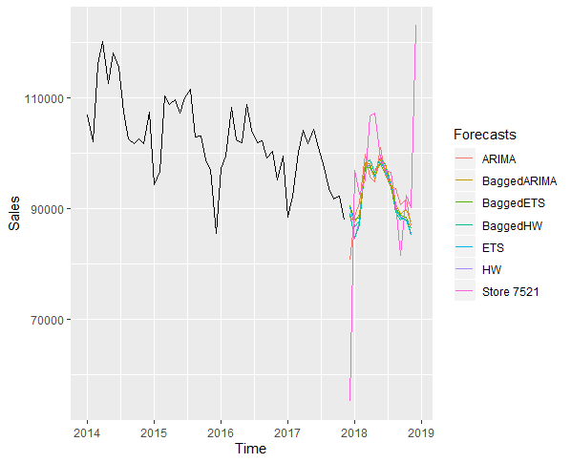
STORE 7521

Slide 33
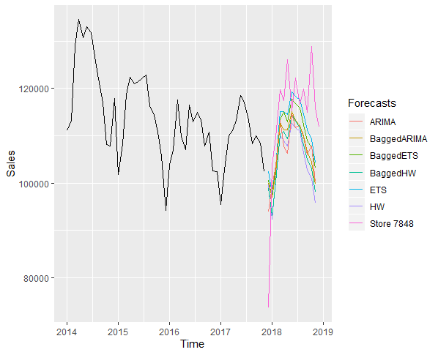
STORE 7848

Slide 34
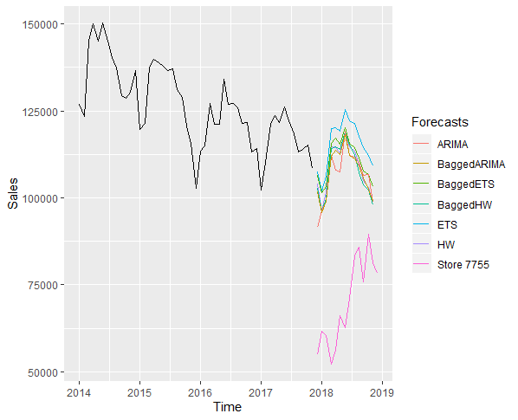
STORE 7755

Slide 35
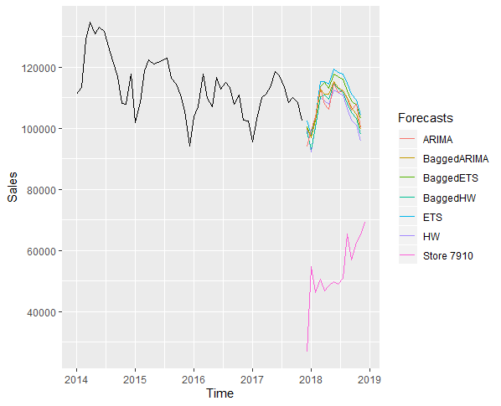
STORE 7910

Slide 36
CONCLUSION
The solution delivers a maximum forecast accuracy over 90% for both Store 7521 and Store 7848 in the test period
However, the design fails for Store 7755 and 7910 where the maximum forecast accuracy is below 50% for both stores
Computing aggregation for each clusters needs further deep-dive to make solution more robust

Slide 37


DEPLOYMENT
Code: The code is published on R and can be run with minimal human intervention and shared on Teams
Dashboard: The Tableau dashboard is published on Tableau Public and can be accessed here
Working paper: The detailed explanation of data used, all methodology used, modelling results are documented onto working paper and shared on Teams

Slide 38
APPENDIX

Slide 39
ABOUT ADVANCE AUTO PARTS
Advance Auto Parts is one of the largest aftermarket automotive parts and accessories retailer in the US with over 5200 company owned stores
One of the key challenge for AAP is to predict new stores sales accurately to maximize ROI

Slide 40
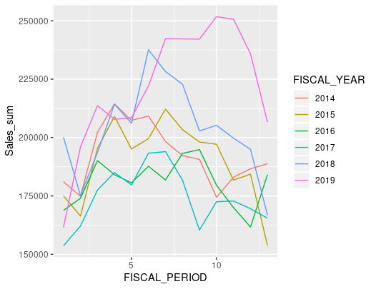
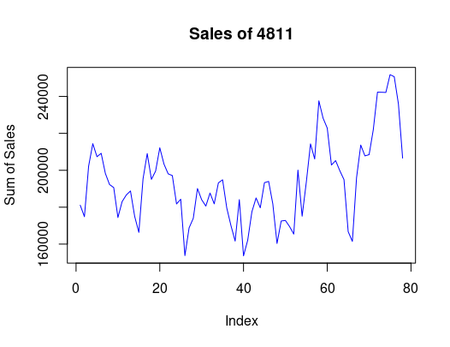
Data Exploration – Store 4811

Slide 41
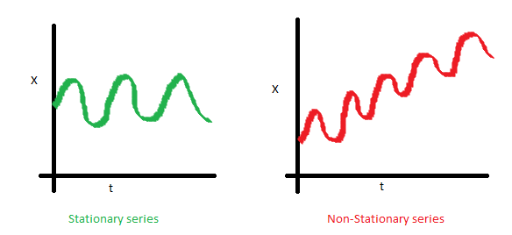
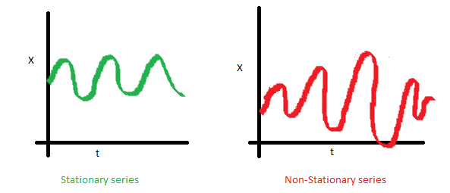
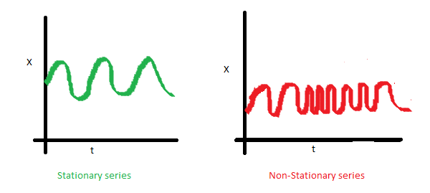
Why is Decomposition required?
Time series data is generally a combination of trend, seasonality, cyclicity and irregular components
Before any time series forecasting we need to make sure our data is stationary
But what is Stationary and why is it important?
A stationary data is one which has constant mean, constant variance and there is no covariance
Constant Mean
Constant Variance
No Covariance
This will help us better understand the time series and can be used to improve the forecast accuracy

Slide 42
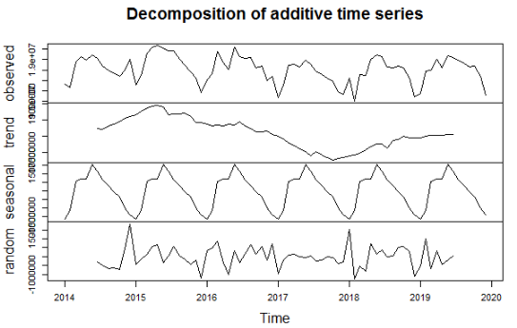
Decomposition chart for DIY

Slide 43
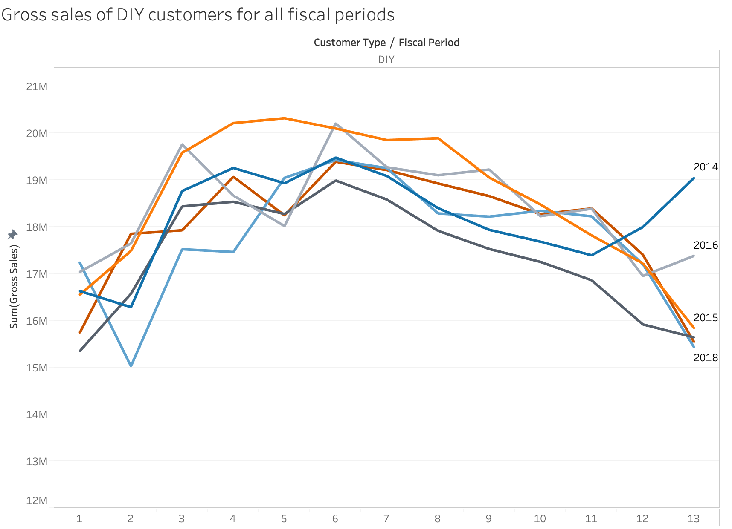
Seasonality of DIY customers

Slide 44
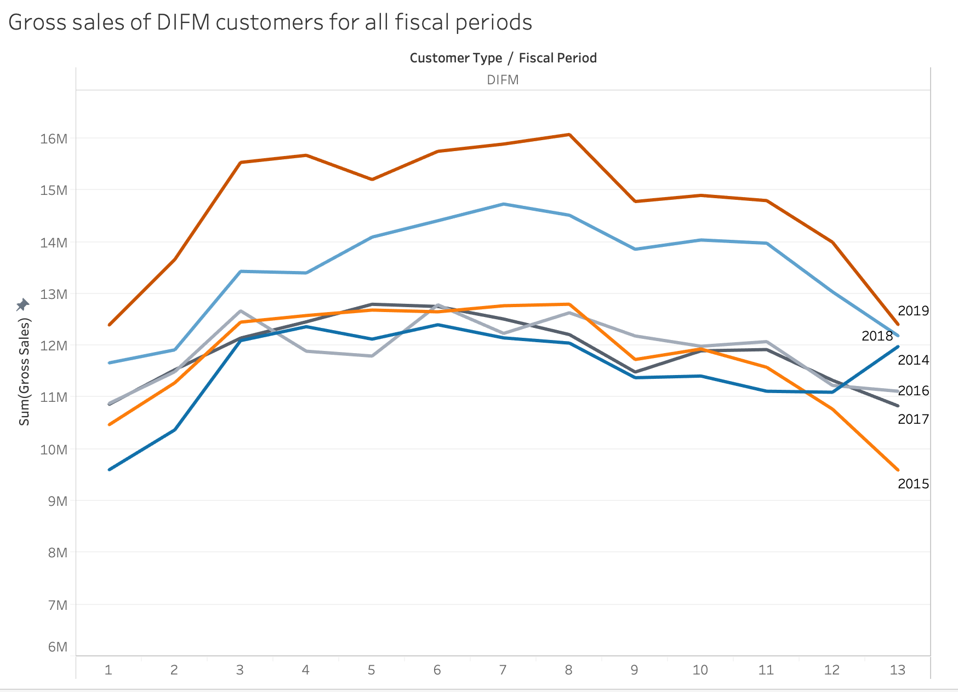
Seasonality of DIFM customers

Slide 45
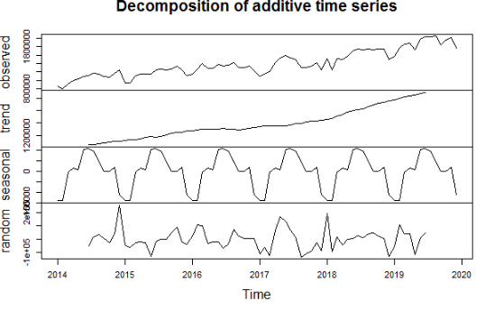
Decomposition chart for Other

Slide 46
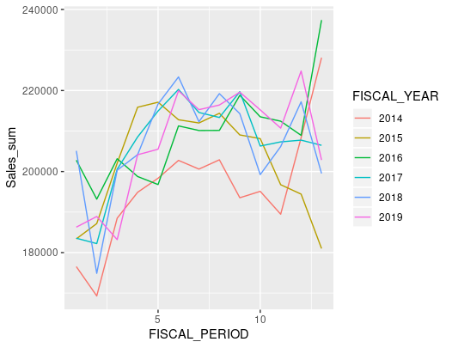
Seasonality for a Product (MPOG_ID = 162)

Slide 47
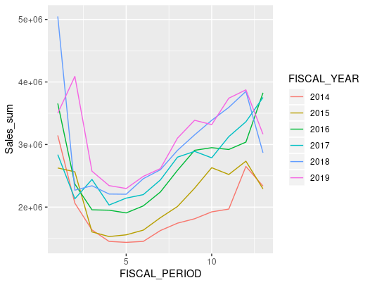
Product with highest Sales (MPOG_ID = 474)

Slide 48
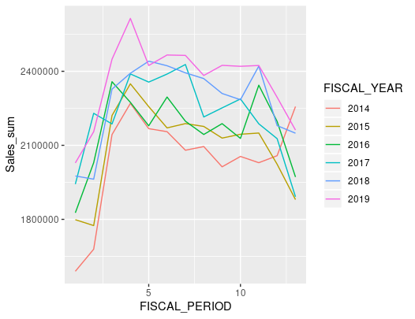
Product with most units sold (MPOG_ID = 144)

Slide 49
Product with greatest AOV (Average Order Value) (MPOG_ID = 215)

Slide 50
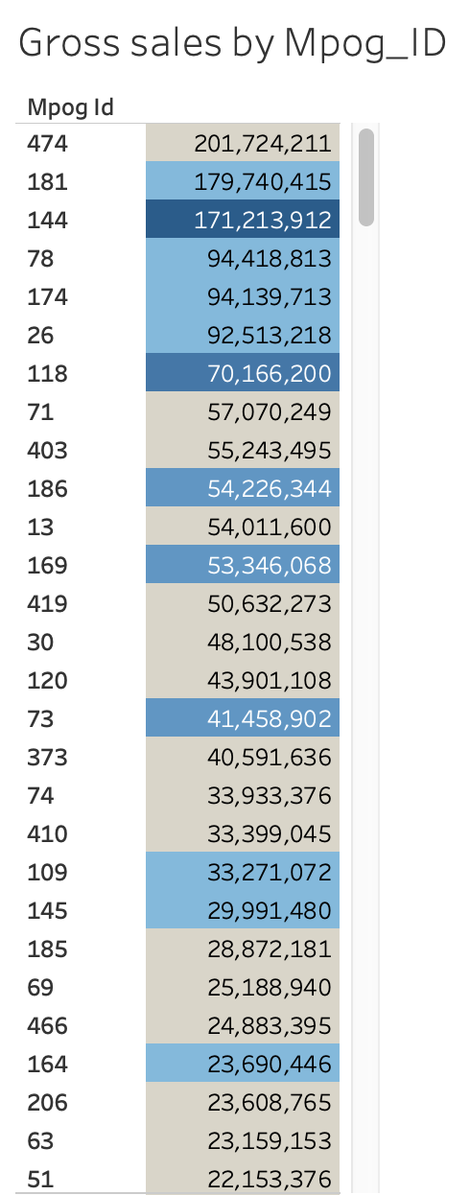
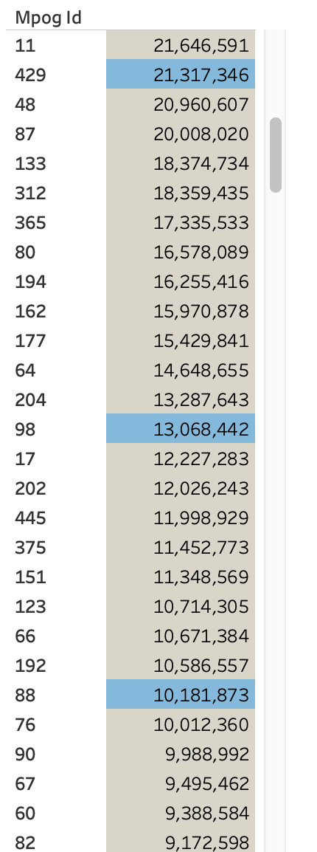
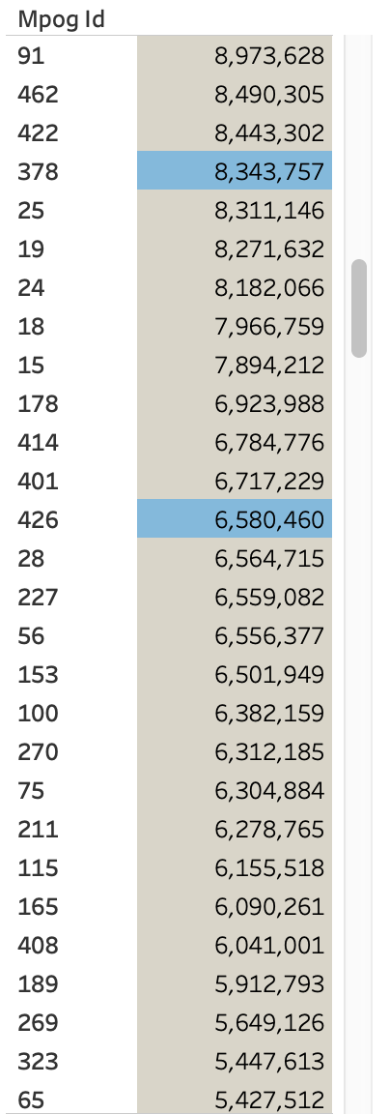
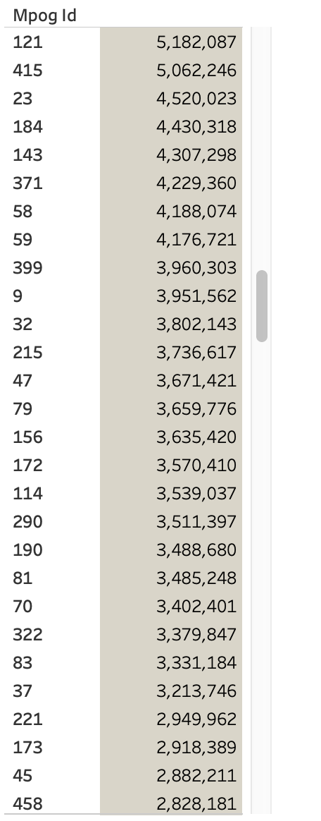
Gross sales and Quantities Sold by MPOG_ID

Slide 51
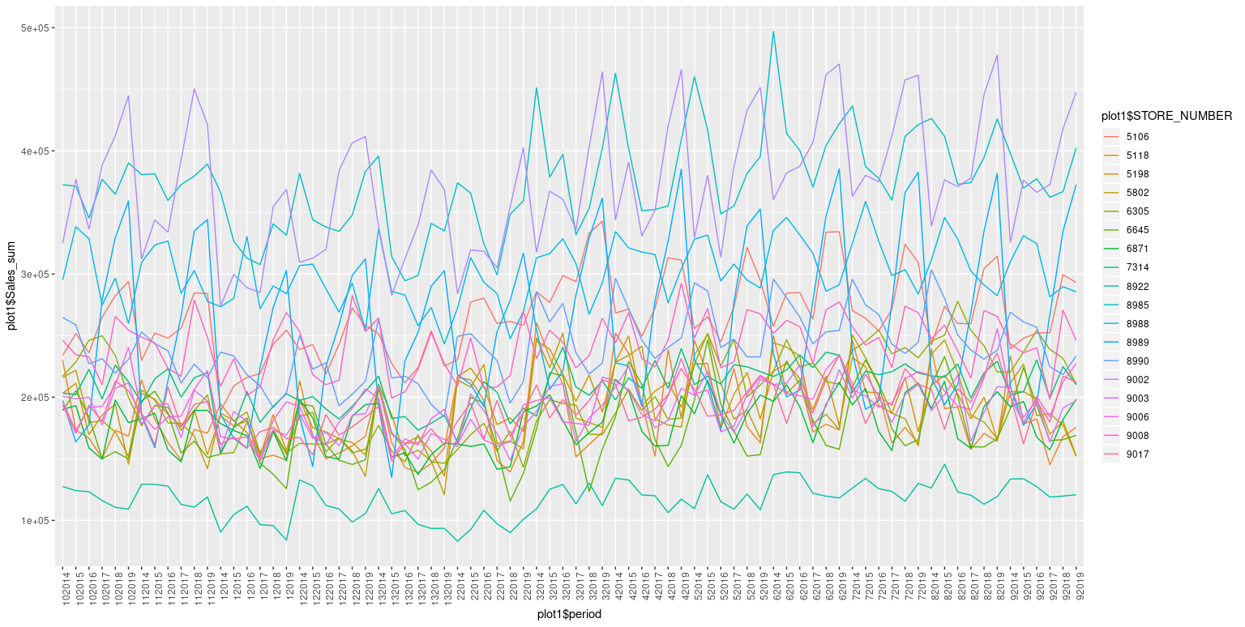
Cluster 1

Slide 52
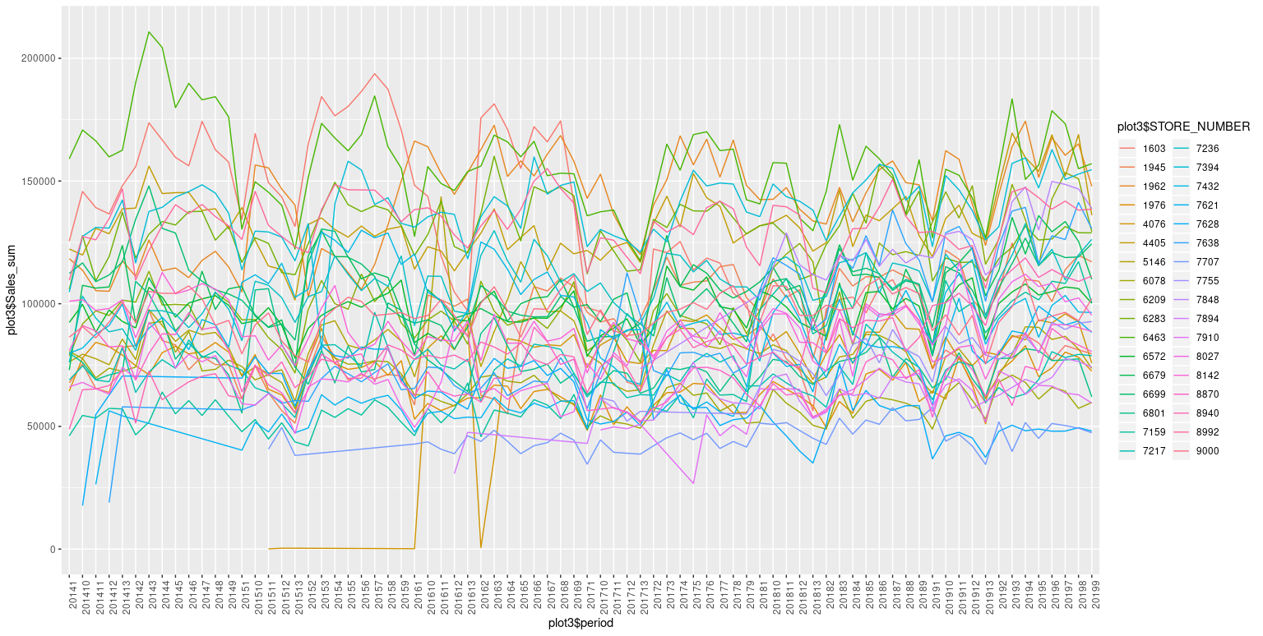
Cluster 3

Slide 53
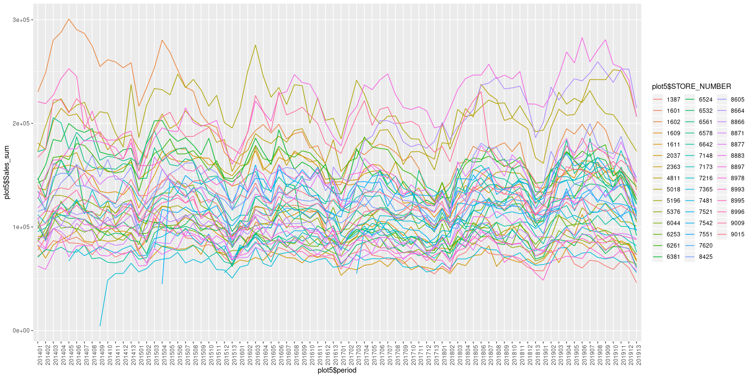
Cluster 5

Slide 54
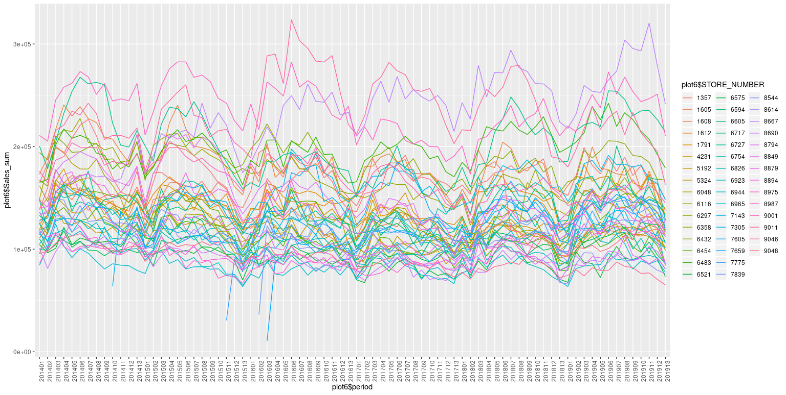
Cluster 6

Slide 55
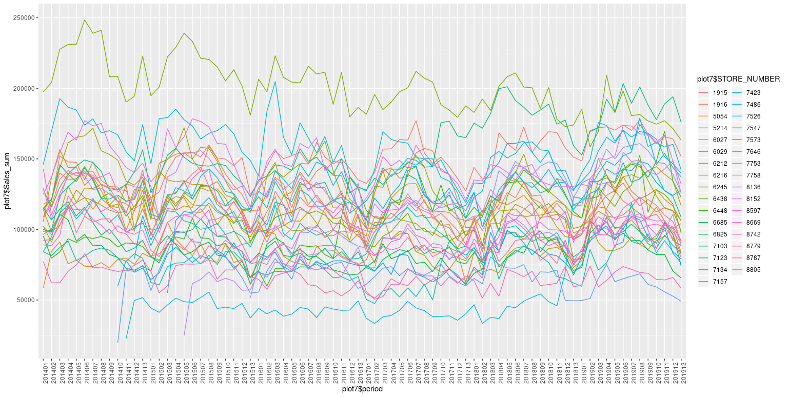
Cluster 7

Slide 56
Solution Flow
In order to forecast sales of a New Store, we can use the average sales of Similar Stores as a proxy for the forecast models
Research suggest that different types of clustering can be used to map similar store
Cluster Existing stores into groups of Similar Stores
Map New Store to Similar Stores
Average Sales of Cluster
Forecast Sales using Average of Sales History

Slide 57





SOLUTION DESIGN - II
01
02
03
04
Raw Data
Processed Data
Data Filter
Data Imputation
Data Manipulation
Data Wrangling
Removed unnecessary columns from the data
Imputed missing values for columns

Slide 58
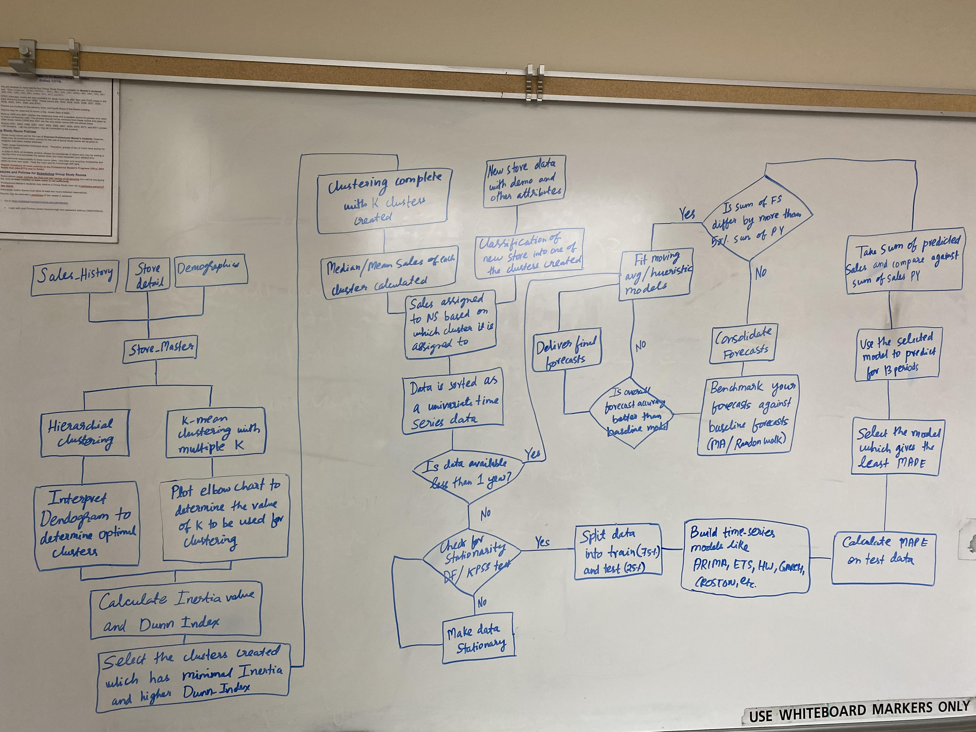
SOLUTION DESIGN – FLOW I

Slide 59
SOLUTION DESIGN – FLOW II
Train/Test split?
We have used Sales_history data combined with demographics data for our clustering exercise
We will use 75% of our data for training and 25% for testing to select the best performing model for both out-sample and in-sample data
Train-test split will help to avoid over-fitting by models
Stat measure
We will be using out-sample MAPE for selecting the best model for time series forecasting
We will compare the MAPE from our selected model against heuristic models(like MA models) and if they are more than 5% better then our model is successful
Stat measure
We will be using K-mean and hierarchical clustering as it is easy to interpret and understand
For our univariate time-series forecasting we will be using ARIMA, ETS, HW and other heuristic model for their ease of interpretability and accuracy

Slide 60
MODELING
Clustering
Classification of new stores to existing store types using features like demographics, inventory, product types, etc. to accurately predict their sales
Is my decision to open a new store in a specific location right?
Qualitative business problem
Quantitative data-driven solutions
Time series forecasting
Supervised learning to forecast store sales using sales history implementing advanced time series forecasting techniques like ARIMA, ETS, HW etc.
What inventory should I sustain for these stores to maximize ROI and minimize loss?
Validation
Train/test and K-fold cross validation
Use standard model evaluation measures like MAE, MSE, RMSE, adjusted R-squared, etc.

Slide 61
Approach
Aggregated the data with their means grouping by the STORE_NUMBER
Dummy coded the categorical variables
Taking k=7 number of centroids, performed k-means clustering
Mapped each store to their respective cluster

Slide 62
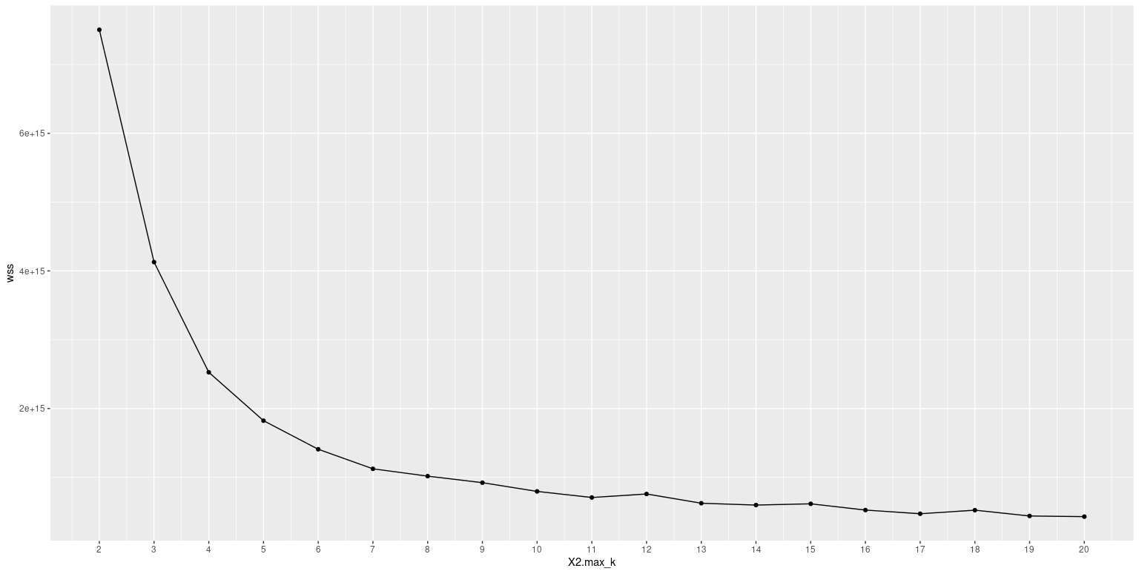
Kmeans Elbow Plot

Slide 63
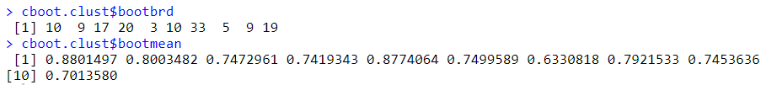
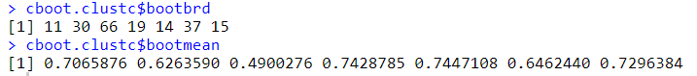
JACCARD COEFFICIENT - I
PAM, k=10
K-means, k=7
CLARA, k=10

Slide 64
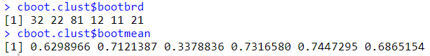
JACCARD COEFFICIENT - II
Hierarchical Clustering, k=8
Spectral Clustering, k=6

Slide 65
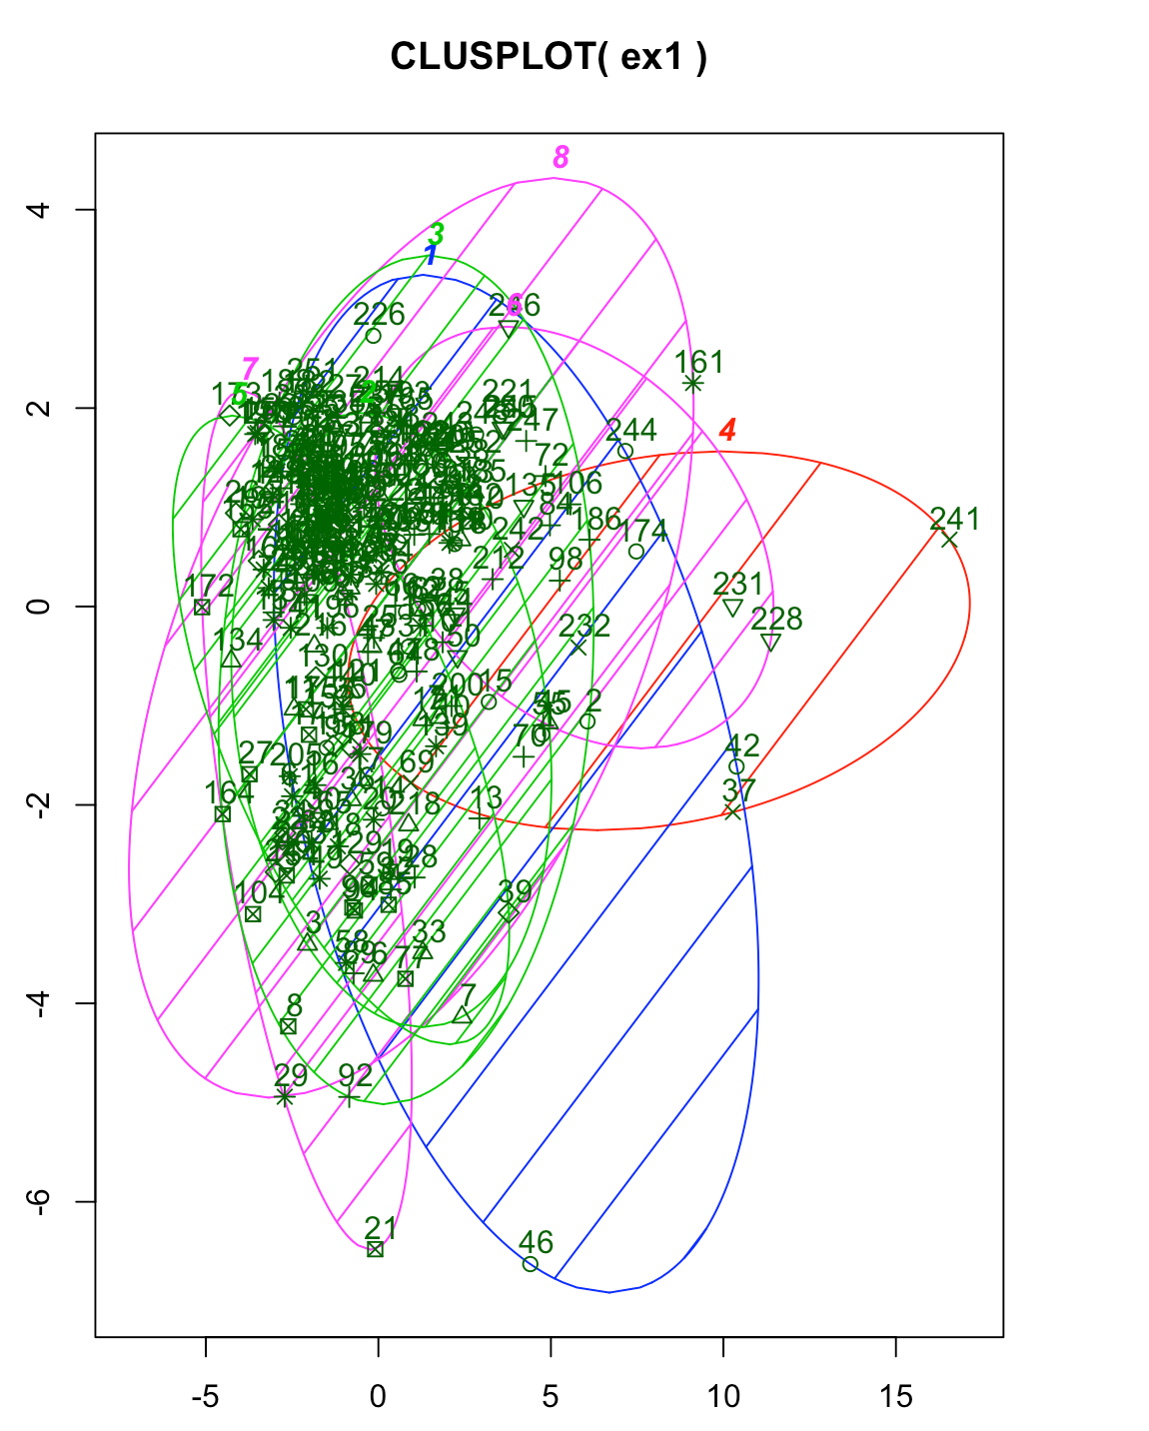

Slide 68
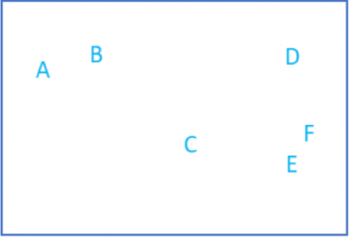
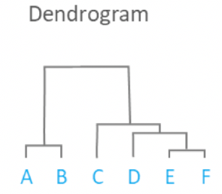
What is Hierarchical Clustering?
Hierarchical Clustering is a method of cluster analysis which seeks to build a hierarchy of clusters. There are two ways how you build hierarchical clustering:
Agglomerative: Bottom-up approach
Divisive: Top-down approach

Slide 69
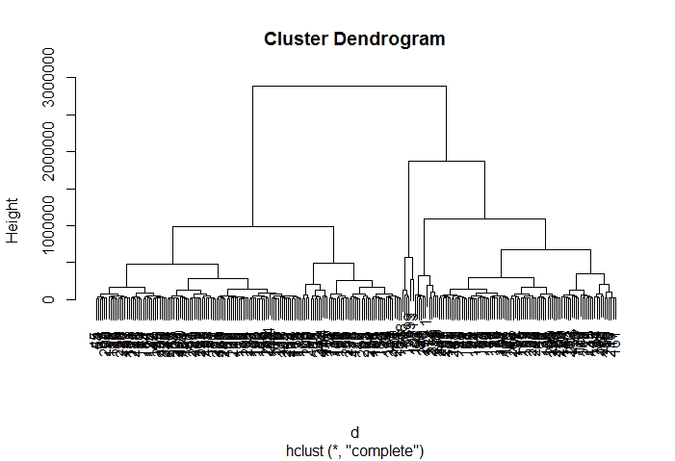
Hierarchical Clustering on our data
Independent attributes taken:
Demographics data like Age, Pop Male, Pop Female, Area Land, Pop density CY, Unemployment rate, Employees, DMA, State, City
Vehicle data like Vehicle count
Store data like store type
In this example we are seeing that 7 clusters should be created
Cluster | # Stores
1 | 12
2 | 101
3 | 49
4 | 27
5 | 60
6 | 4
7 | 2

Slide 70
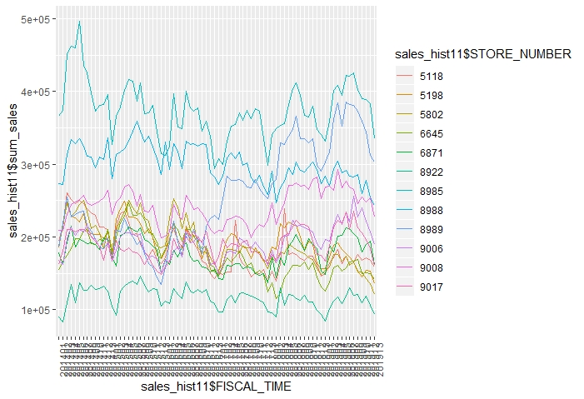
Results of clustering
CLUSTER 1

Slide 71
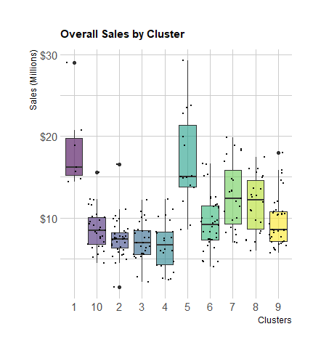
Cluster Evaluation

Slide 72
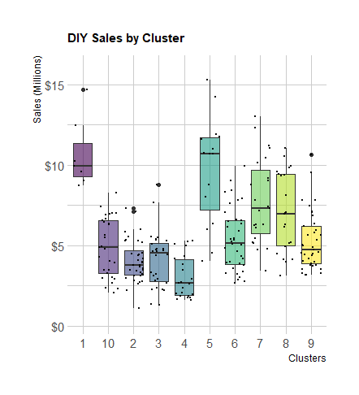

Cluster Evaluation

Slide 73

Cluster Evaluation

Slide 74

Cluster Evaluation

Slide 75


Slide 76

Cluster 2

Slide 77

Cluster 4

Slide 78


Slide 79

xs

Slide 80
Cluster Evaluation

Slide 81
Cluster Evaluation

Slide 82
MODELING
Clustering
Classification of new stores to existing store types using features like demographics, inventory, product types, etc. to accurately predict their sales
Is my decision to open a new store in a specific location right?
Qualitative business problem
Quantitative data-driven solutions
Time series forecasting
Supervised learning to forecast store sales using sales history implementing advanced time series forecasting techniques like ARIMA, ETS, HW etc.
What inventory should I sustain for these stores to maximize ROI and minimize loss?
Validation
Train/test and K-fold cross validation
Use standard model evaluation measures like MAE, MSE, RMSE, adjusted R-squared, etc.

Slide 83



Slide 84
What is Exponential Smoothing?
Uses smoothing method of weighted averages
Exponential Smoothing assigns exponentially decreasing weights as the observation get older
Recent observations are given relatively more weight in forecasting than the older observations.
HoltWinters: Method of Exponential Smoothing
Takes trend and seasonality into account

Slide 85


Slide 86
01
Meeting minutes

Slide 87
Kick-off Call
Attendees: Perry Pinion, Kara Odum, Mathew Lanham, Sukhsagar, Snehalatha, Srishti and Vikas
Date and Time: 3:30-4:00 pm EST, 17/01/20
Primary Presenter: Mathew Lanham
Agenda: Kick-off Call | Industry Practicum | Advanced Auto Parts
Discussion Points:
Introduction of AAP team by Perry and Kara. Perry gave a quick synopsis of data engineering, programming and data analysis teams and their respective work
Project walkthrough:
Predicting sales accurately leads adjusting for seasonality integral to low inventory costs, lesser opportunity losses and higher ROI
However predicting sales of multiple parts in newly opened stores challenging without sales history
Focus on assortment algorithm at new stores and forecasting of a given part for a new store
Need to cluster newly opened store considering attributes common to existing stores. Leveraging this clustering need to successfully forecast sales implementing advanced time series forecasting techniques
Need to understand important factors which drive sales from data and success metrics
Action Items | Primary Owner | ETA | Status
Go through data and clarify questions if any | Team Krannert | 01/28 | Completed
Perform primary EDA and clarify discrepancies if any | Team Krannert | 01/28 | Completed

Slide 88
02
Meeting minutes

Slide 89
Data Clarification Call
Attendees: Kara Odum, Sukhsagar, Snehalatha, Srishti and Vikas
Date and Time: 2:00-2:30 pm EST, 28/01/20
Primary Presenter: Vikas Das
Agenda: Clarifications on Problem Scope and Data| Industry Practicum | Advanced Auto Parts
Discussion Points:
Problem Scope:
Assortment of new store may not be available to us
Classification of stores may not be necessary, primary goal is to forecast sales for 1 year. Added benefit includes forecast at Customer Type + Year-Moth level and Product Category + Year-Month level
Front of Store sales vs Back of Store sales would be nice, but is unavailable in the data provided’
Team currently do not use a model to estimate sales of new stores
Software used by clients: R, Python and Tableau
Data:
Sales and Quantity sold appear to be negative in a number of stores; impute negative values to zero for now
Part numbers sometimes match SKU numbers, but there are a significant amount of missing SKU numbers
Action Items | Primary Owner | ETA | Status
Look into stores with negative sales and quantity sold | Kara | 2/4/2020

Slide 90
01
Sprint Reviews

Slide 91

SPRINT REVIEW
Proposed | Status | Comments
1. Kickoff call with client |  | Project walkthrough and expectations by client team
2. Exploratory data analysis |  | Find missing values, outliers, correlation and table relationships
3. Data and modeling clarification with client | to be held on 01/28 | Discuss methods to treat outliers and missing values, propose effective modeling techniques for the problem statement

Slide 92
02
Sprint Reviews

Slide 93
SPRINT REVIEW
Proposed | Status | Assigned to | Comments
1. Call with client team on 01/28/2020 |  | Everyone | Further clarity on problem statement, discussed missing values and outlier treatments, addressed negative sales in sales_history table
2. Missing values and outlier treatments |  | Vikas and Snehalatha | Treatment of missing values through appropriate imputations
3. Addressing negative sales in sales_history table |  | Sukhsagar | Waiting for the client team to clarify further
4. EDA visualizations |  | Srishti and Snehalatha | Visualized findings from EDA using R and Tableau

